Slide 1
Instructions for RoboFlow Annotation
Amin Zehtabian
November 2023

Slide 2
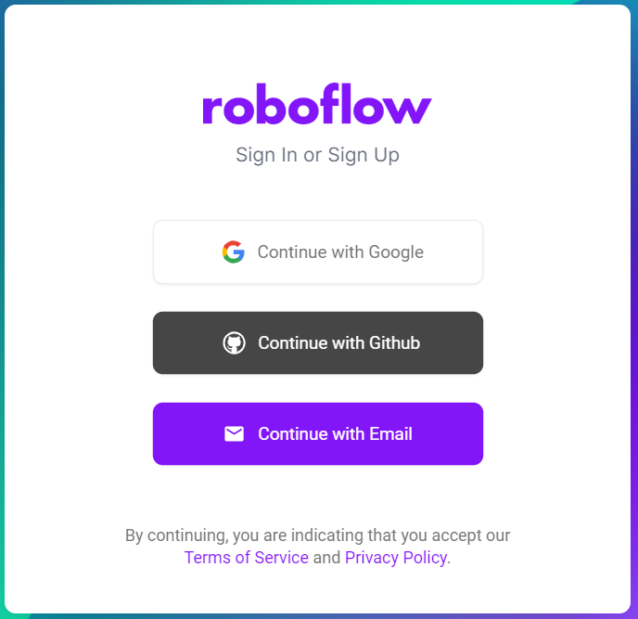
First, sign in at https://app.roboflow.com/login.
You have the option to create a new account or use your existing Google or GitHub accounts to log in.

Slide 3
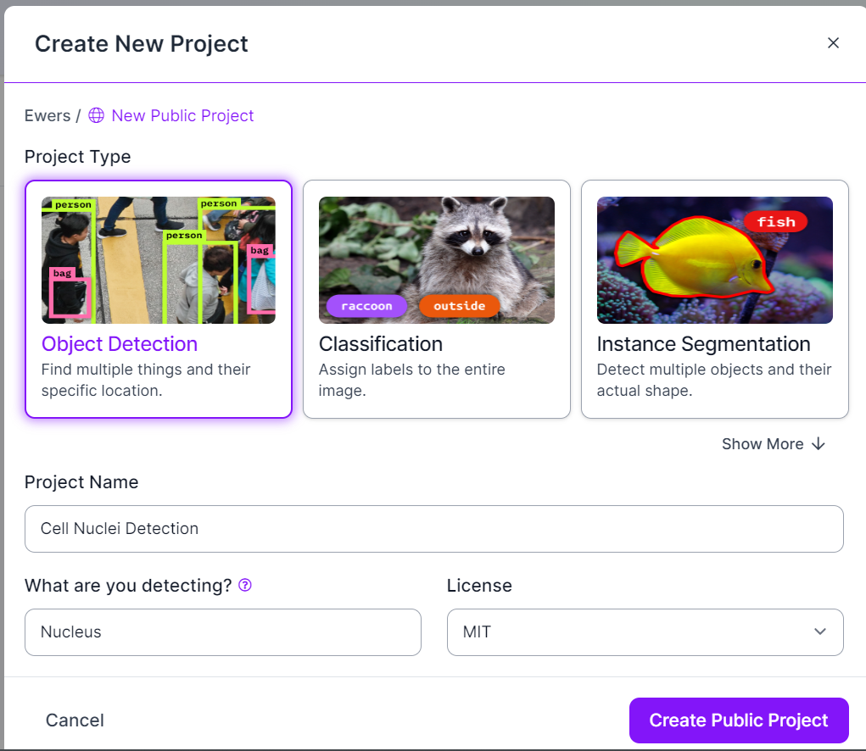
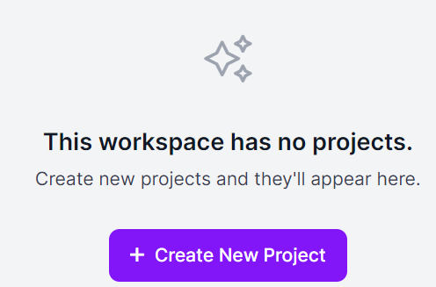
After signing in, you can start a new project from the Roboflow dashboard.
Remember to select the appropriate project type. We'll begin with 'Object Detection’.
Note that with a free membership, your data will be public and accessible to all other users. With that in mind, let's proceed to upload some publicly-available data

Slide 4
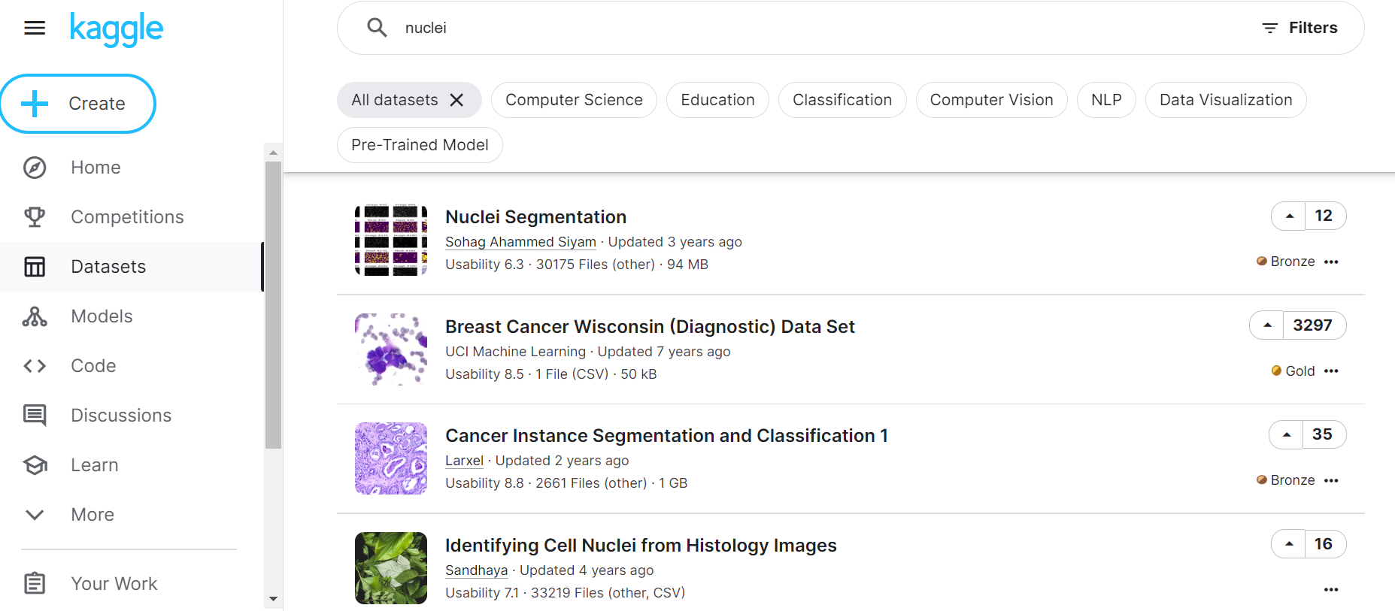
There are many publicly-available datasets.
One of the most famous databases is Kaggle: https://www.kaggle.com/

Slide 5
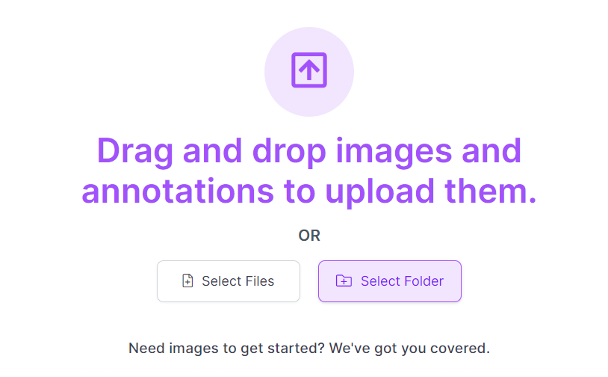
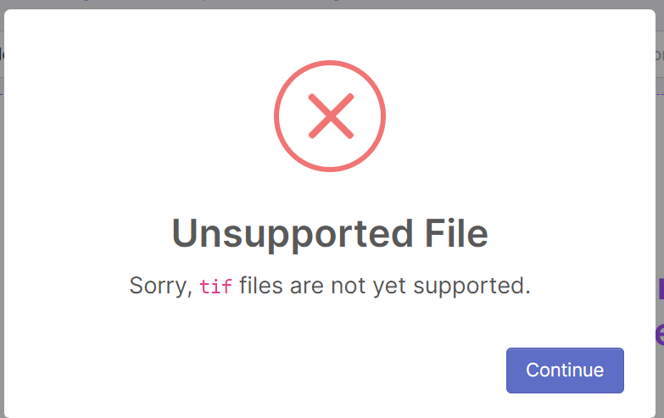
Let’s start annotating a couple of frames in a movie of dividing cells, via Roboflow:
Be noted that tif files are not supported

Slide 6
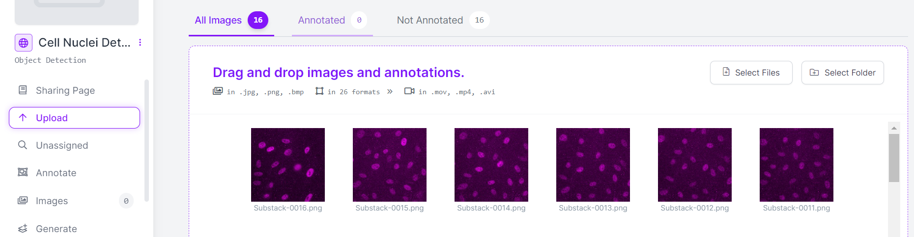
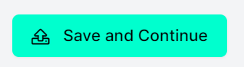
16 images uploaded on Roboflow:
After uploading, choose Save and Continue:

Slide 7
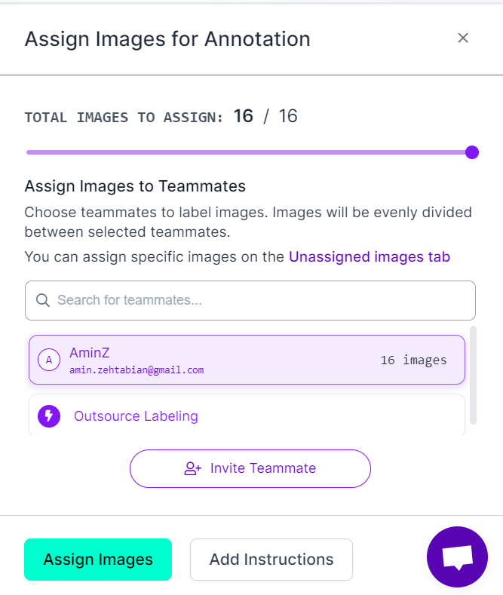
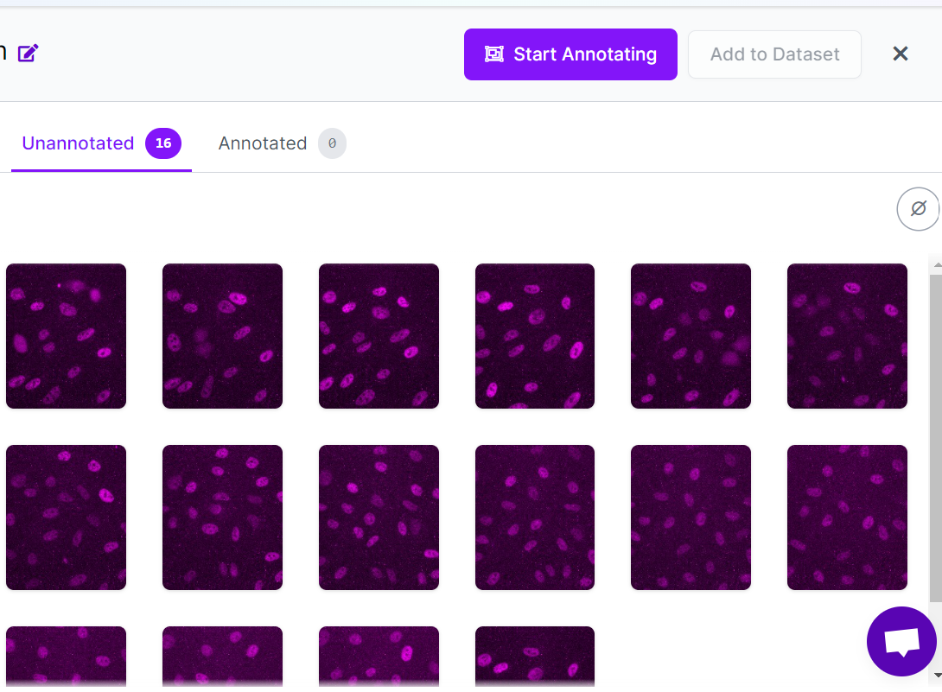
Then Assign images:
And Start Annotating:

Slide 8
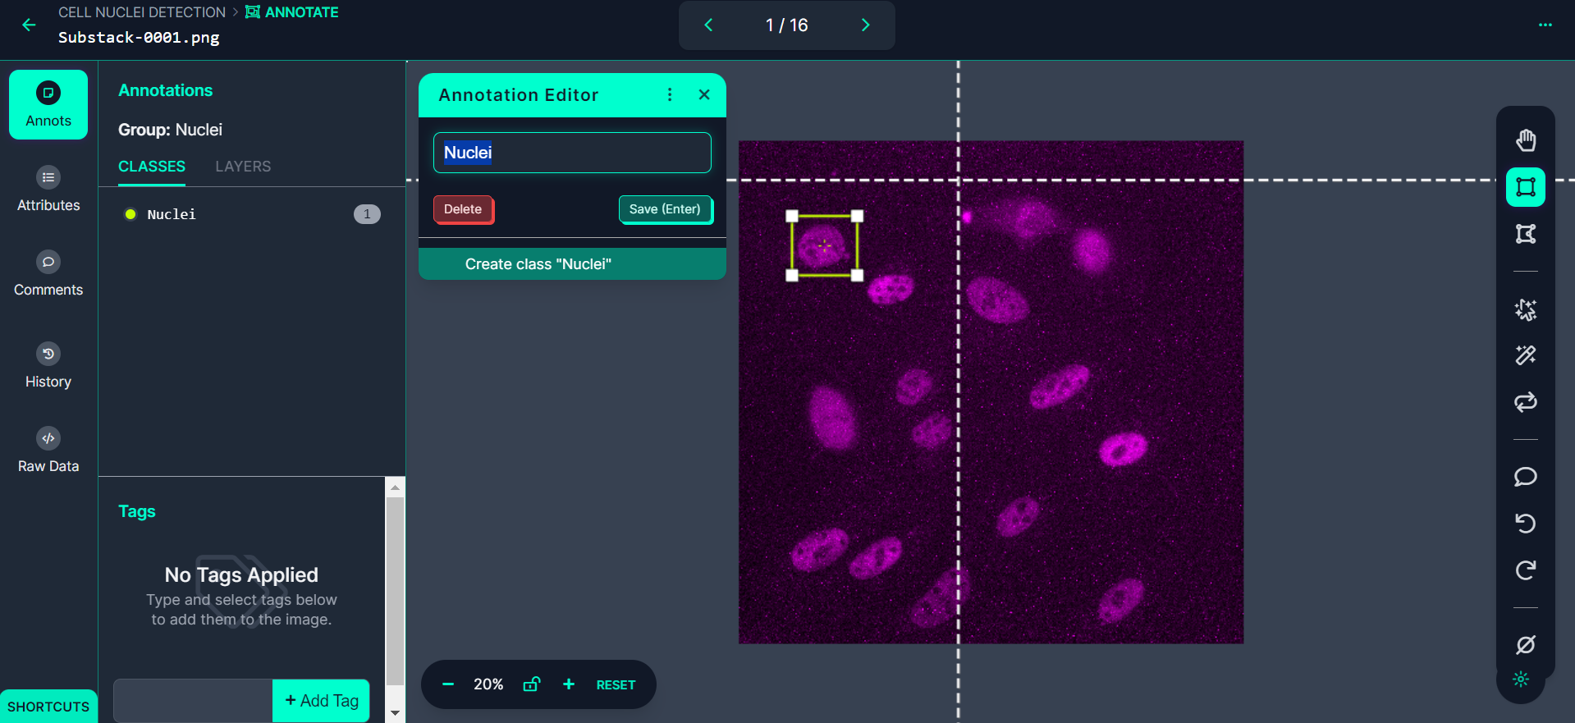

Slide 9
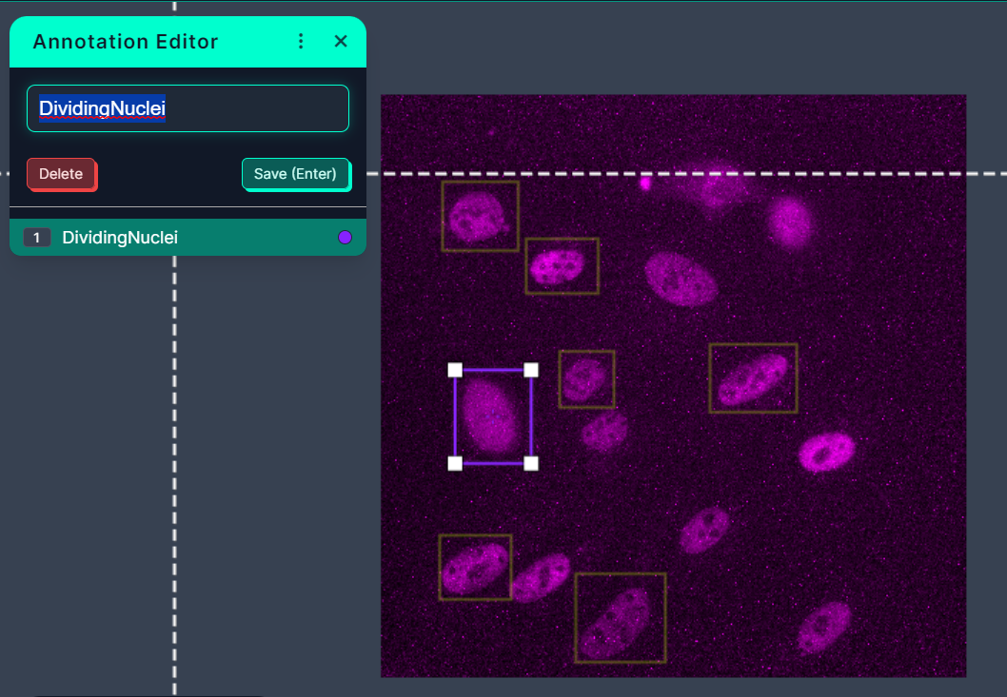
We could annotate with more than one label (multi-class training)

Slide 10
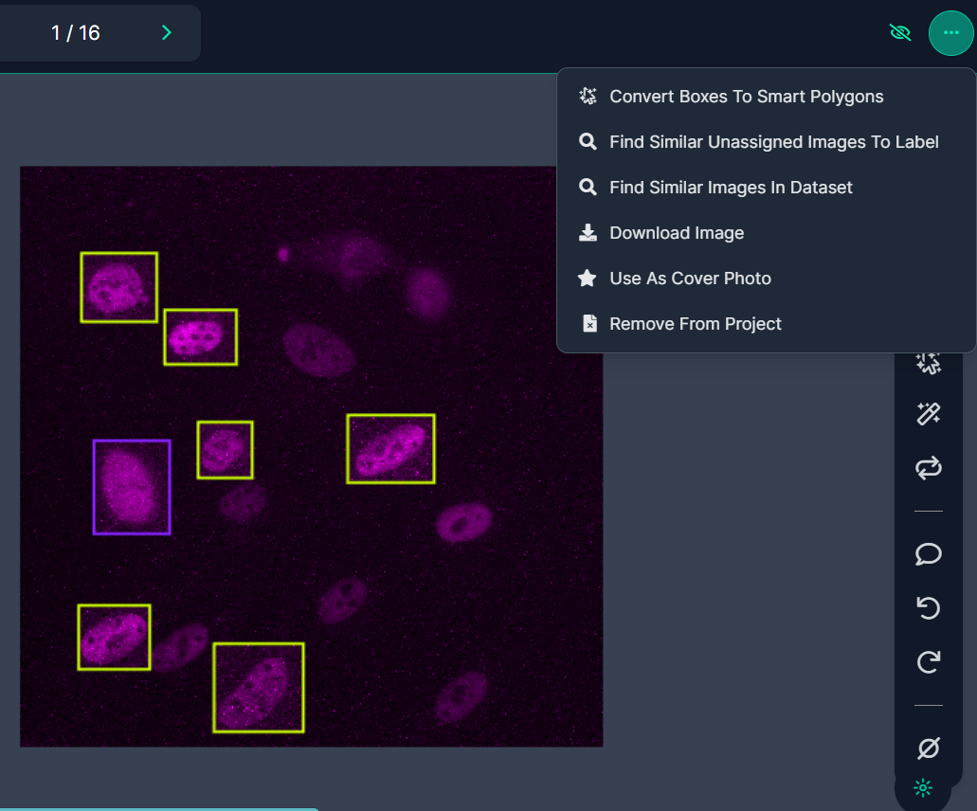
Once the annotation is completed, the following options will be available:

Slide 11
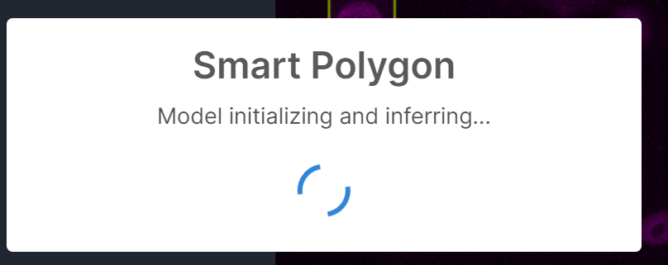
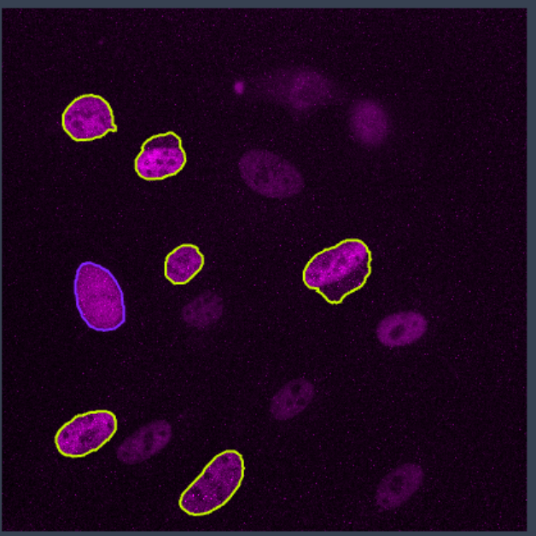
If the 'Convert to Smart Polygon' option is chosen (this is for segmentation training, which is not currently required),

Slide 12
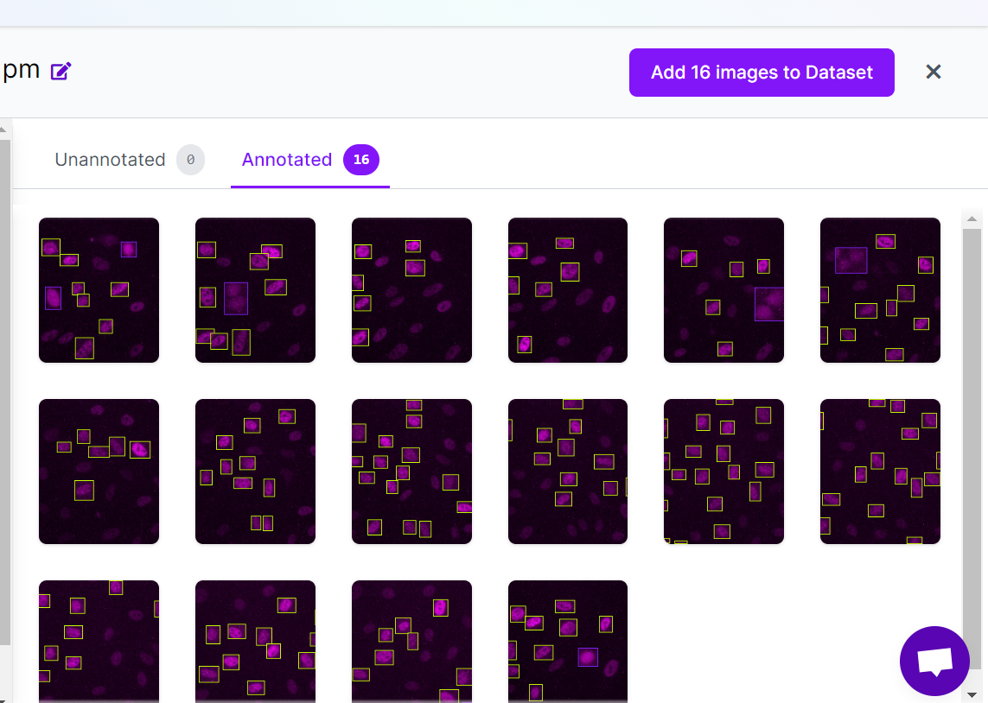
We now add the annotated images to Dataset:

Slide 13
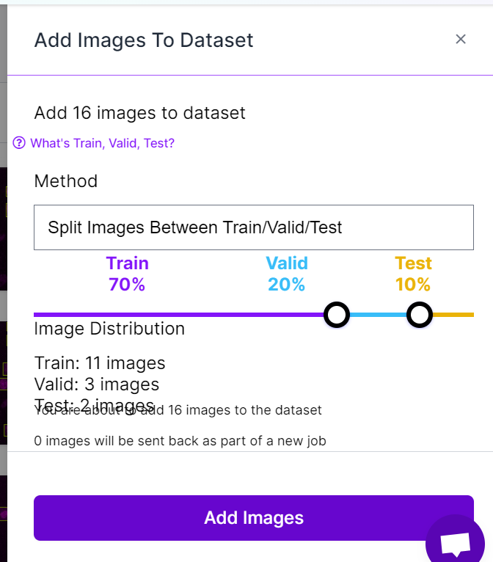
Choose the subset of data to be used for training; the remainder will be reserved for validating and testing the trained model.

Slide 14
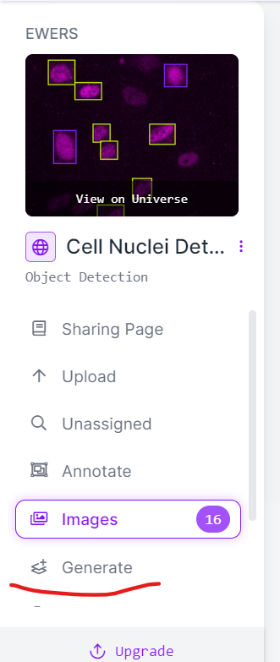
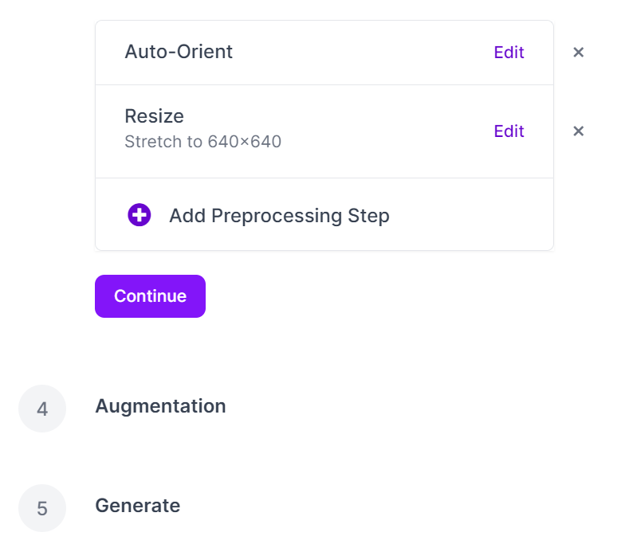
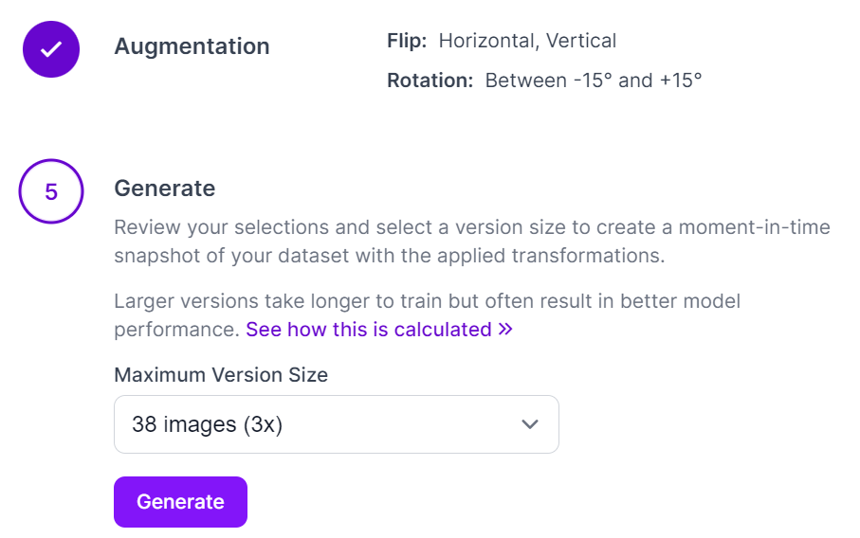
Generate the Dataset:

Slide 15
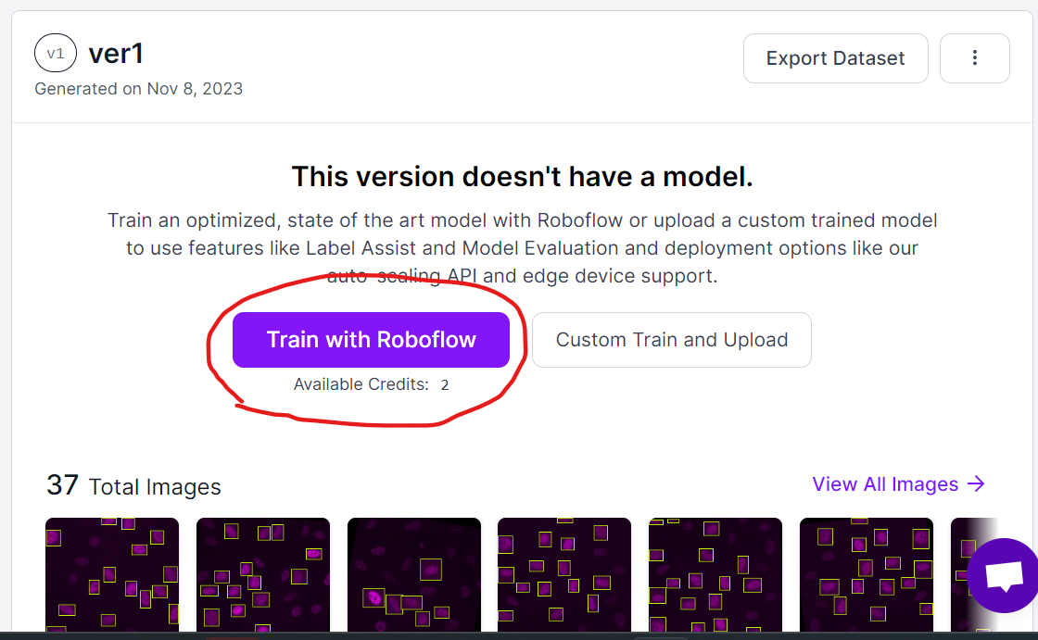
After generating the training set, you can train a model with Roboflow.
This step is not necessary, since we only need the training sets to be used for training our YOLOv8 model.

Slide 16
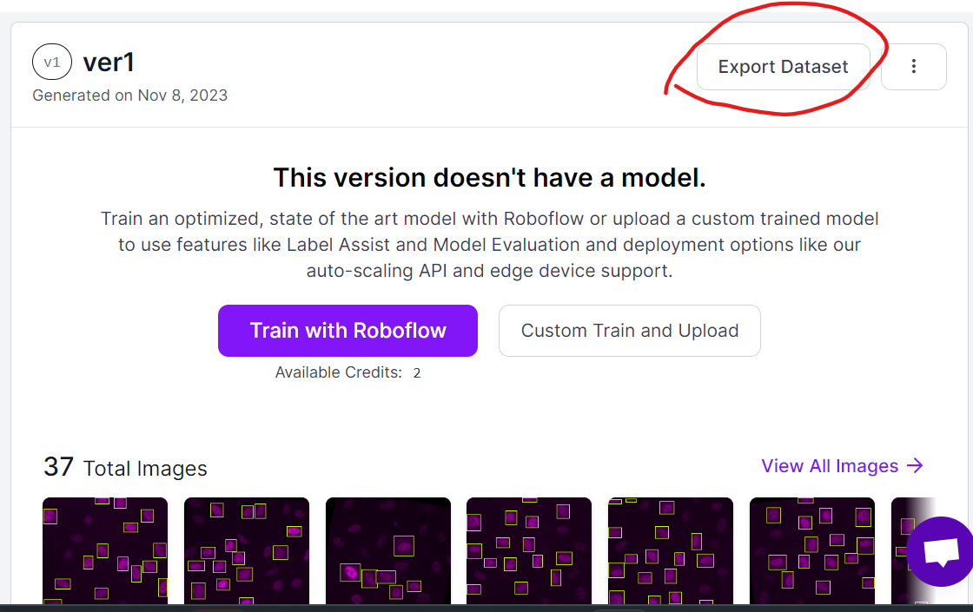
Instead, we export the training set for training our YOLOv8 model:

Slide 17
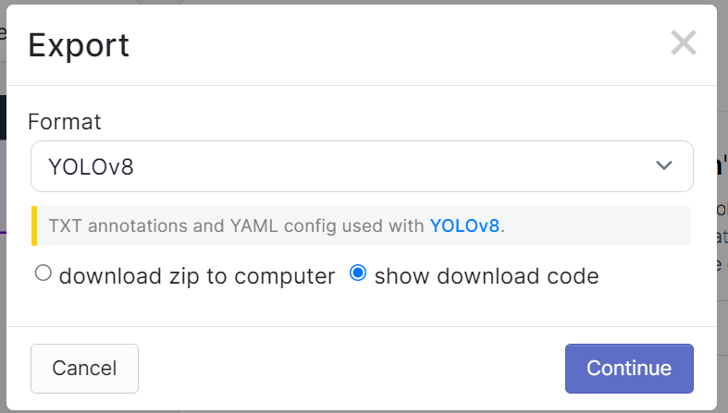
The generated training dataset can be exported as a zip file for later loading into the DL model, or it can be represented as a code, commonly referred to as an 'API_KEY', which can be easily copied and pasted into the YOLO notebook.
In either case, ensure that the dataset is exported in the YOLOv8 format:

Slide 18
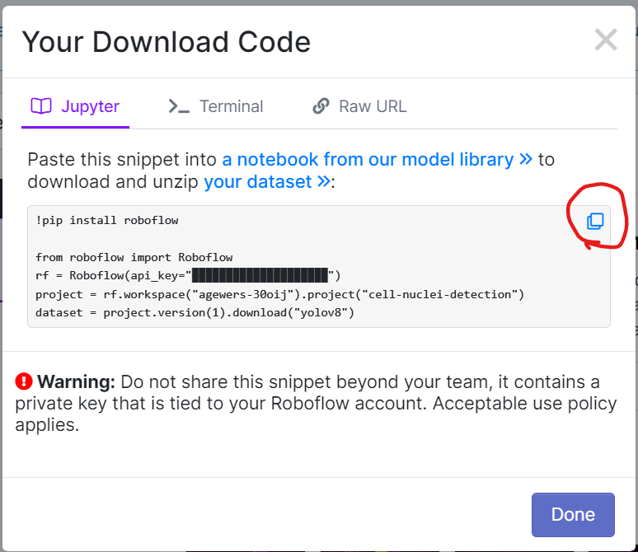
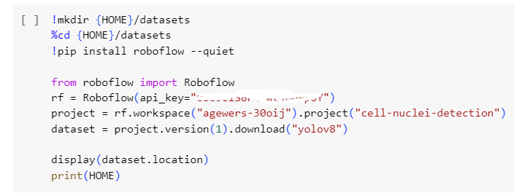
The generated 'API_KEY’ (left) can be copied and pasted into the YOLO notebook (right):

